Slide 1
3rd Annual Stanford Wrestling Coaches & Leaders Clinic
Being innovative & working smarter
at the high school level
Deciding on your team's internal operating system, creating a culture of self-reliance, and using software to make it stick.
Matt Sencenbaugh
Daniel McCune
Founder, WrestlingIQ
Athletic Director, Fremont High School
Block 2 · 10:45 AM – 12:15 PM · Kissick Auditorium (Room 02) · Saturday, September 12, 2026
Notes:
90-minute session.
Original working title: "Being innovative & working smarter at the high school level."
Subtitle (updated by Matt): Deciding on your team's internal operating system, creating a culture of self-reliance, and using software to make it stick.
Presenters: Matt Sencenbaugh (session lead) with Daniel McCune, Athletic Director at Fremont High School.
Ray Blake is not in the room. His material has been reassigned: slide 10's rule is now unattributed, and slides 13 and 24 are built as live segments for Dan from the AD's chair.
Dan's segments: 13 (the AD's perspective), 24 (what gets a tool approved), 27 (common AI mistakes).

Slide 2
THE NEXT 90 MINUTES
Four decisions that give you your time back
01
02
03
04
Communication
Attendance & logistics
Booster payments
AI
Information architecture and building a team that is self-reliant.
Gear, weight, video, practice planning — one system, good data.
Modernizing the money stack without the district red tape.
Does it even matter?
Hot and cold takes.
Pick the smallest number of tools that covers all of this. Every extra system is another place your team forgets to look.
Screenshots throughout use WrestlingIQ, but the ideas apply to whatever software you use.
WrestlingIQ
3rd Annual Coaches & Leaders Clinic · Stanford · Sept 12, 2026
Notes:
Have them raise their hands, how many tools do they use right now? Keep your hands off if you use more than one for communication, attendance, booster payments, AI integrations, video review.

Slide 3
FRAMING
What does “working smarter” actually mean?
Save time on admin tasks
70+% of all customers coming to WrestlingIQ rank this as their #1 goal.
Create a shared culture of expectations
You don’t scale if you keep answering the same questions over and over—and it will make you miserable.
Spend more time on the parts you like
Coaching, cheering, being in the room. That's the whole point of being involved in wrestling.
It is not about buying more software. It is about deciding on your team’s information architecture and sticking with the plan consistently.
WrestlingIQ
3rd Annual Coaches & Leaders Clinic · Stanford · Sept 12, 2026
Notes:
Original notes:
- Save time on admin tasks
- Create a shared culture of expectations for wrestlers, parents, managers, and coaches
- Increase the time spent doing the things you like doing (coaching, cheering, etc)

Slide 4
01
Communication
Get everyone on the same page, moving in the same direction.
WrestlingIQ
3rd Annual Coaches & Leaders Clinic · Stanford · Sept 12, 2026

Slide 5
COMMUNICATION
The hardest, most frustrating part of running a team
Get everyone on the same page, moving in the same direction.
It’s always happening
Practice changes, weigh-ins, rides, forms, tournaments, the one parent who missed it.
It's one of the biggest parts of running a team
Whether the coach does it themself or creates a system for others to operate, information architecture matters.
Done well, everything downstream gets easier
If people don’t know what’s happening they can’t support you well.
WrestlingIQ
3rd Annual Coaches & Leaders Clinic · Stanford · Sept 12, 2026
Notes:
Original notes:
- The hardest, most frustrating part of running a team
- But one of the head coach's most important jobs
- Get everyone on same page, moving in the same direction

Slide 6
CHANNELS
Not every message belongs in the same place
WrestlingIQ - Team messaging app
YOUR TEAM
Your current roster and their parents. Fast, direct, and the only place high-schoolers reliably look.
Email, newsletter, your website
ENGAGED COMMUNITY
Alumni, core fans, extended family, admin, school board. Common newsletter mistake - use plain text, not graphics
Social media (and local press)
BROADER COMMUNITY
Celebrate the team! This is where social shines, and where you keep it positive.
WrestlingIQ
3rd Annual Coaches & Leaders Clinic · Stanford · Sept 12, 2026
Notes:
Original notes:
Social media for your broader community and those outside it (tells your story). Emails/newsletters for engaged stakeholders (parents, alumni, admin, school board). Then WIQ for your team and parents — how you communicate quickly and succinctly, and the only place HS kids are sure to check (they don't read emails or check X/Facebook).
The bottom two tiers tell your story and keep things positive. The top tier keeps those with the most active roles in the loop.
Bottom tier: fans and broader community, potential fans in the team's orbit. Social shines here; old-school things like newspapers still matter in certain communities.
Middle tier: alumni, core fans (including parents of current wrestlers), extended family. Own website and email newsletters shine.
Top tier: current active team. WIQ messaging — cover parent vs wrestler settings, SafeSport settings, and navigating 'official communication' district settings.

Slide 7
CHANNELS
Getting the top tier right with team messaging
WHO SEES IT
COMPLIANCE
PRECISION
Parent vs. wrestler settings
SafeSport & district rules
Roster-synced groups
Decide deliberately who receives what. Some messages are for athletes, some are for the adults, some are for both.
Configure official-communication settings so every coach-to-athlete message is visible and on the record.
Groups that update themselves when the roster changes. Send to only the people who need to know.
If a message can be shared, make it shareable. A link to the calendar beats a paragraph retyped four times in four places. We’ll go deep on this in a second.
WrestlingIQ
3rd Annual Coaches & Leaders Clinic · Stanford · Sept 12, 2026
Notes:
From the original theme list: understanding the hierarchy of communication tools; communicate clearly and succinctly; roster-synced groups; send to only the people who need to know; send shareable things. SafeSport settings in WIQ and navigating 'official communication' district settings.

Slide 8
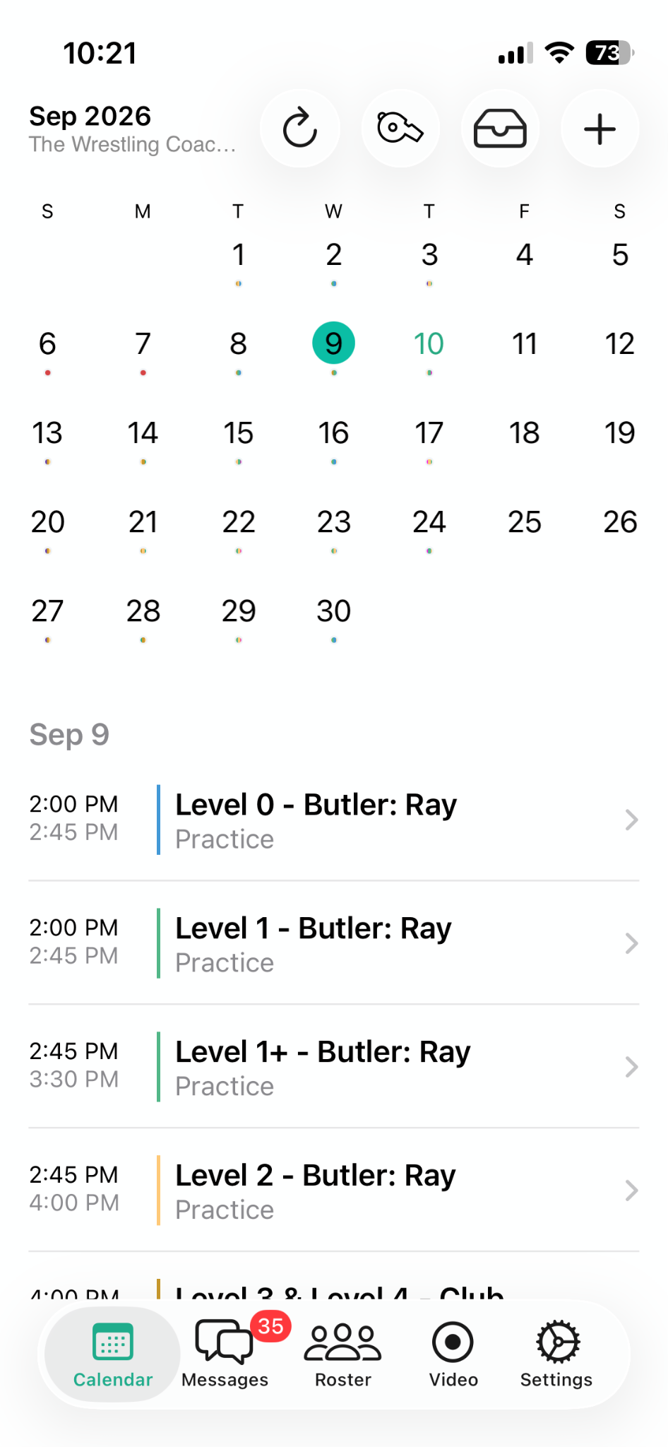
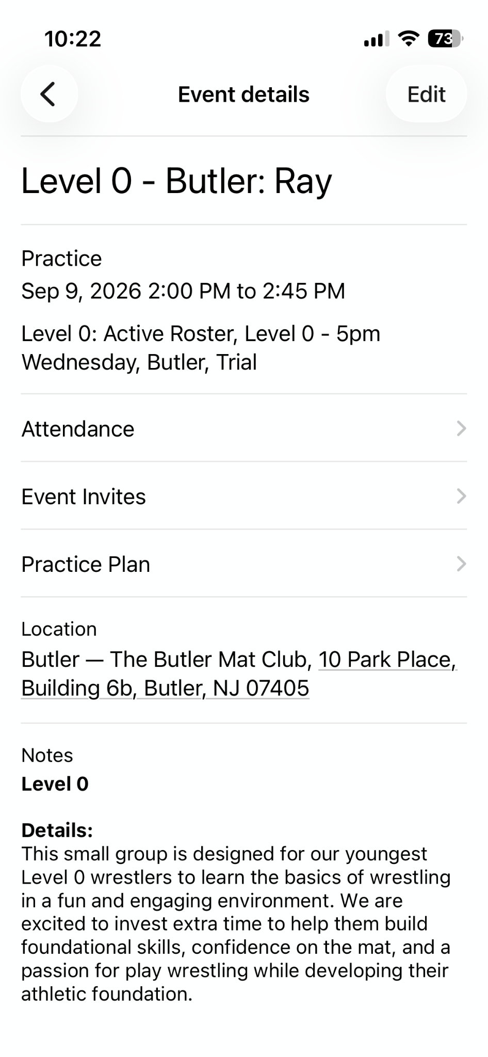
PRACTICES
Set up a team calendar
One calendar, kept current
If it isn't on the calendar, it isn't happening. No exceptions, all season.
Notes on every event
Use a template: address, what to bring, expectations, who, absence policy, etc
Roster linkage
Let families filter to "my kid's schedule" instead of reading everyone's.
Color coding and filters
Varsity, JV, girls, open mat — visible at a glance if your system supports it.
WrestlingIQ
3rd Annual Coaches & Leaders Clinic · Stanford · Sept 12, 2026
Notes:
Original notes:
- How to set up a team schedule properly
- Create a good example of a notes template from Jeff
- Target kids with the "my kids schedule" feature
- Ideally have some way to let parents see what they need to care about
- Color coding, or filters, if your system supports it
- Deeply using notes, roster linkage, color coding and more on the WIQ calendar
OPEN: get the notes template from Jeff, and grab fresh iOS app screenshots.

Slide 9
CULTURE
Creating a culture of self-reliance
Answering the question yourself is faster today and more expensive every day after.
Redirect, don't answer
“Hey there — please see the team calendar for full details. We work hard to keep that up to date and it'll always be your best source of info.”
Every time you answer what the calendar already says, you teach people not to check it.
Give your staff the script
Same words from every coach, every time. Consistency is what makes it land.
Put the reference material somewhere permanent
A team documents section beats re-explaining the same five things every August.
Say it kindly, but say it every time.
WrestlingIQ
3rd Annual Coaches & Leaders Clinic · Stanford · Sept 12, 2026
Notes:
Original notes:
The hardest part. Coach has to repeatedly tell people to check the team calendar instead of providing the answers for this to actually work. May seem easier to answer a question, but refusing to do so forces the wrestlers and parents to get on the software and check the calendar frequently. Much easier long term.
Give scripts and what to say. Provide reference materials in the team documents section of WIQ.

Slide 10
CADENCE
How often, and to whom
THE RISK
ANOTHER RISK
Be succinct
Over-communicating
Under-communicating
Too many messages and people stop reading any of them. The important one gets lost in the noise.
Nobody ever quit a program because they were too well informed. If you must err, err loud.
Point to shared resources
Target the right people
The rule: it is better to over-communicate than under-communicate, but keep your messages short with full details found elsewhere (aka the calendar).
The fix for noise isn't fewer messages — it's tighter segmentation. Send less to more people, and more to the few who need it.
WrestlingIQ
3rd Annual Coaches & Leaders Clinic · Stanford · Sept 12, 2026
Notes:
Original notes:
There is real risk of over communication. Communicate succinctly, point to shared resources, and make sure you are targeting the right people with the right messages.
The over-communicate rule came from Ray Blake, who isn't presenting — it now stands on its own, unattributed.

Slide 11
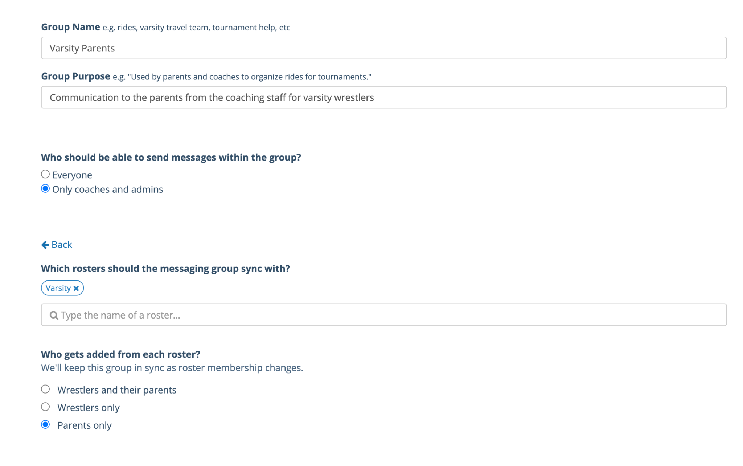
COMMUNICATION MISTAKE
Control the behavior in official team messaging
Turn off sending permissions for everyone
This cuts down on messaging fatigue
Create sub groups for parent planning
Curate the group if parent to parent planning is helpful
WIQ messaging settings
Roster linkage
Segmentation is hard without automation
Create a celebrations channel (maybe)
Honestly? This is what social media and your newsletter are for, not team messaging.
WrestlingIQ
3rd Annual Coaches & Leaders Clinic · Stanford · Sept 12, 2026
Notes:
Original notes:
- How to set up a team schedule properly
- Create a good example of a notes template from Jeff
- Target kids with the "my kids schedule" feature
- Ideally have some way to let parents see what they need to care about
- Color coding, or filters, if your system supports it
- Deeply using notes, roster linkage, color coding and more on the WIQ calendar
OPEN: get the notes template from Jeff, and grab fresh iOS app screenshots.

Slide 12
PLANNING
Pre-load the season before the season
OFF-SEASON
PRE-SEASON
IN-SEASON
POST-SEASON
Build the calendar
Schedule them
Adjust, don't author
Save the good ones
Every message you know you'll send, with dates and action items.
Load them into scheduled messages before week one hits.
You're editing a plan instead of writing from scratch at 10pm.
Evergreen messages get reused next year, and the year after.
Messages worth writing once and re-using forever:
First practice details · What to bring to the first competition · Resources for first-time parents · Weigh-in procedure · Post-season banquet
WrestlingIQ
3rd Annual Coaches & Leaders Clinic · Stanford · Sept 12, 2026
Notes:
Original notes:
- Full season calendar of communication schedule, with dates and action items
- Using WIQ scheduled messages to set this all up before the season starts
- Important messages you can re-use year over year: first practice, what to bring to the first competition, resources for first time parents, etc.
- Using Buffer or other social media scheduling tools to schedule your promos
OPEN: Ray's advice on social scheduling and how to create graphics — Matt flagged "let's chat on this, I'm not quite sure I understand exactly what you're looking for." Resolve before the clinic or cut the social-scheduling beat.

Slide 13
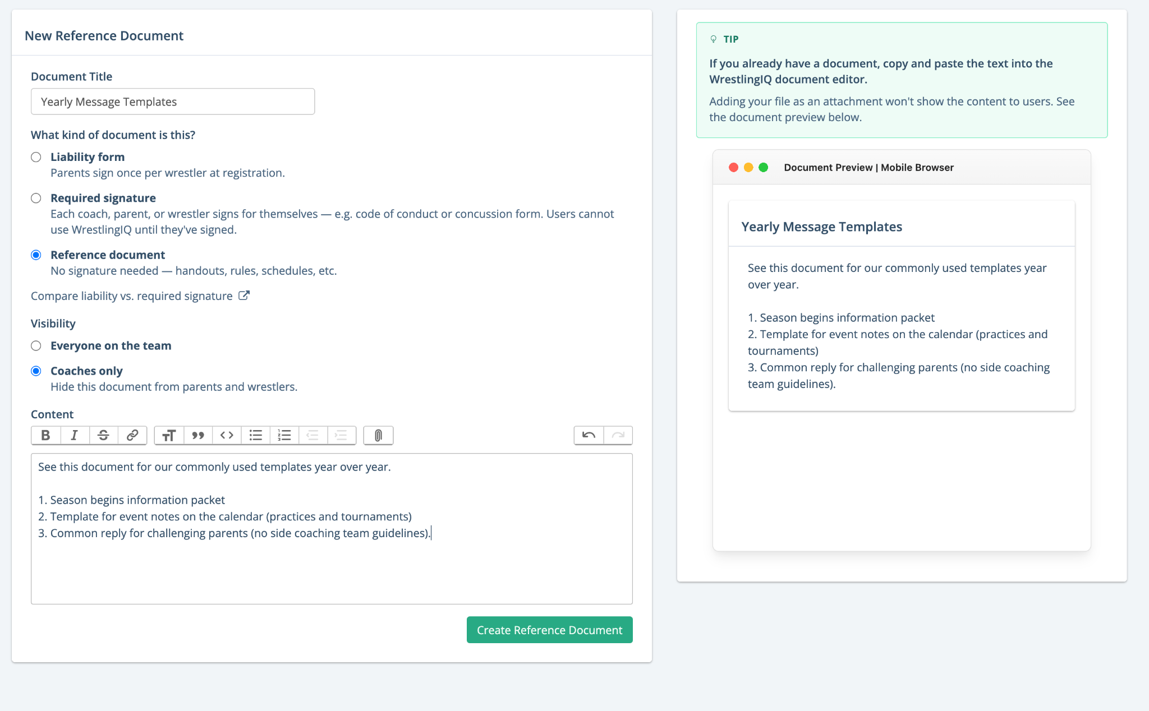
PLANNING
Keep one source of truth
One home for past messages
Last year's version is the fastest first draft you'll ever get.
One home for common messages
The five things you explain every single season, written well, once.
Stored where the next coach can find it
A team document library outlives any one person's inbox.
The test: if you got hit by a bus in December, could your assistant run the program's communication from what's written down?
WrestlingIQ
3rd Annual Coaches & Leaders Clinic · Stanford · Sept 12, 2026
Notes:
Original notes:
- Keep one source of truth for past messages and common messages
- Pull from Jeff here
- Example of WIQ document storing all of this for year over year reference
OPEN: get Jeff's example document.

Slide 14
STAKEHOLDERS
The athletic director's perspective
ASK
ASK
ASK
What do you actually need from me?
What makes your job harder?
What are the district rules?
Format, frequency, and which system. Ask once, then automate it.
Usually it's surprises. Most AD friction is an information-timing problem.
Official communication, records retention, and who is allowed to message athletes.
The goal: communicate in a way that makes your wrestlers, your parents, your AD, and your broader community all feel safe.
WrestlingIQ
3rd Annual Coaches & Leaders Clinic · Stanford · Sept 12, 2026
Notes:
Original notes:
How does an athletic director feel about communication? How to navigate communicating with your team that will make your wrestlers, parents, athletic directors, and broader community feel safe.
Also from the theme list: relationship with the AD matters.
This is Dan's segment. He is the AD at Fremont High School, so he can answer these three questions from the other side of the desk instead of you speculating about them.
Line worth landing verbally: a good relationship with your AD is a communication system, not a personality trait.
OPEN: confirm with Dan how he wants to run it — straight answers to the three questions, or open Q&A with the room.

Slide 15
02
Attendance & team logistics
Tracking data without losing your mind.
WrestlingIQ
3rd Annual Coaches & Leaders Clinic · Stanford · Sept 12, 2026

Slide 16
ATTENDANCE
Garbage in, garbage out
Attendance data is only worth having if the process that produces it is boring and identical every day.
STEP 1
STEP 2
Self check-in at the kiosk
Roll call during warm-ups
Wrestlers check themselves in as they walk in the door. Add weight capture here if you track it — one stop, one habit.
A manager or coach verifies the list while warm-ups run, and explicitly marks absent anyone who isn't there.
The explicit absent mark is the part everyone skips — and it's the part that makes every report downstream trustworthy.
WrestlingIQ
3rd Annual Coaches & Leaders Clinic · Stanford · Sept 12, 2026
Notes:
Original notes:
- Self check-in with the kiosk, potentially with weight tracking if enabled
- Managers or coach does a roll call while warm-ups happen to double check and explicitly mark wrestlers absent who aren't there.

Slide 17
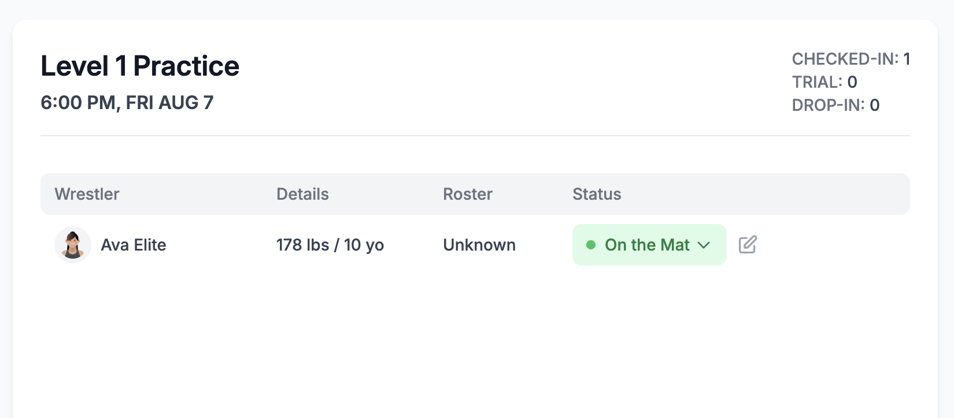
ATTENDANCE
What the data is actually for
Reporting to your AD
If they require a separate system, ask them for the specific features you need.
"Who hasn't shown up in a week?"
That one report is the whole reason to collect this. Ask for it by name.
Checking in on kids who are drifting
Attendance is an early-warning system before it's a compliance record.
WrestlingIQ
3rd Annual Coaches & Leaders Clinic · Stanford · Sept 12, 2026
Notes:
Original notes:
- Reporting to AD, or if they require a separate attendance system make sure to ask them for specific features like "how can I know who hasn't shown up last week?"
- Checking in with kids who are struggling and not showing up
- Screenshot of the last practice attended report in WrestlingIQ

Slide 18
LOGISTICS
The rest of the operating system
EQUIPMENT
Gear checkouts
Who has the singlet, the headgear, the warm-up — and did it come back in March.
DEVELOPMENT
PLANNING
Video + stats
Practice planning
Match recordings, timestamps, clips, and scouting your next opponent.
Most useful in the first weeks of the season, when the plan is still forming.
WrestlingIQ
3rd Annual Coaches & Leaders Clinic · Stanford · Sept 12, 2026
Notes:
Original notes (slides 15 & 16):
Gear checkouts, weight tracking, match video review, practice planning. ("Is attendance just another part of this?" — yes, treated as its own section here.)
- Using WIQ private properties for tracking gear checkouts
- Weight tracking via the WIQ kiosk
- Stats + video with WIQ; web player to create highlight videos from WIQ match recordings; scouting
- Engagement ideas: assigning coaches to review videos, WIQ smart timestamps for review, team film-study practice
OPEN: do we showcase the WIQ practice planner? Not quite the right product, but some people find value in the first several weeks.

Slide 19
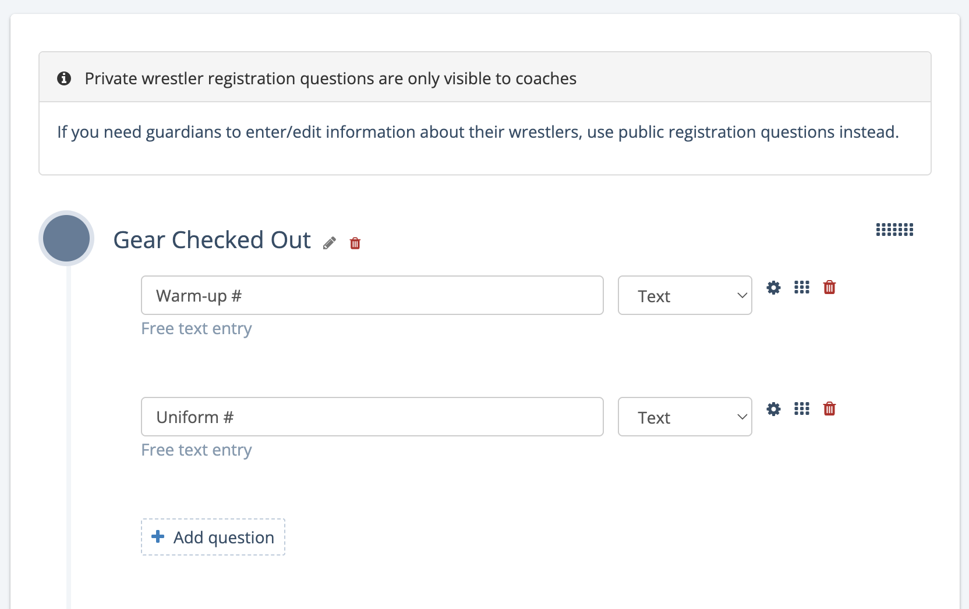
LOGISTICS
Tracking gear checkouts
Use private properties on the profile
Singlet number, headgear, warm-up size — attached to the wrestler, not a clipboard.
Coaches see it, families don't
Private fields keep internal notes internal while staying on the athlete record.
Pull the roster report at end of season
One export tells you exactly what's outstanding and who to ask.
WrestlingIQ
3rd Annual Coaches & Leaders Clinic · Stanford · Sept 12, 2026
Notes:
Original notes:
- Using WIQ private properties for tracking gear checkouts
- Pulling the roster report

Slide 20
LOGISTICS
Video + stats: habits of effective programs
CAPTURE
REVIEW
Assign it to someone
Smart timestamps
Managers record by default. Let parents and wrestlers record too — more angles, more matches, zero cost.
Jump straight to the scramble instead of scrubbing through six minutes to find it.
SHARE
SCOUTING
Cut clips on the web player
Study the opponent
Build highlight reels from match recordings. Show them at practice, send them to YouTube, send them to college coaches.
The same library that develops your wrestlers tells you what's coming at the next dual.
WrestlingIQ
3rd Annual Coaches & Leaders Clinic · Stanford · Sept 12, 2026
Notes:
Original notes:
- Managers assigned to record the video
- Let parents and kids record matches too
- Scouting opponents
- Smart timestamps to jump to specific parts in the video
- Using web video to cut out clips for film review
- Show at practice, send to YouTube etc
Engagement question for the room: what makes film review actually happen in a screen-based era? Assigning coaches to review, team film-study practices.

Slide 21
LOGISTICS
Practice planning: be honest about the tool
WHERE IT HELPS
WHERE IT HELPS
WHERE IT DOESN'T
The first few weeks
Handing off the room
Mid-season, veteran staff
When the season's structure is still forming, writing the plan down forces the decisions you're avoiding.
An assistant can run practice from a written plan. They cannot run it from your memory.
By January most staffs plan in their heads and in the hallway. Forcing software here usually adds friction.
Every tool has a season where it earns its keep. Knowing when to stop using one is part of running a good system.
WrestlingIQ
3rd Annual Coaches & Leaders Clinic · Stanford · Sept 12, 2026
Notes:
Original note: "Review webinar from Jeff about practice planning and using software to do it."
Also from slide 16: "Do we want to showcase WIQ practice planner at all here? It's not quite the right product but some people do find value particularly in the first several weeks of practice."
OPEN: watch Jeff's webinar and decide how hard to push the practice planner. This slide currently takes the honest position — adjust if you'd rather demo it.

Slide 22
03
Booster payments
Modernizing your payments stack.
WrestlingIQ
3rd Annual Coaches & Leaders Clinic · Stanford · Sept 12, 2026

Slide 23
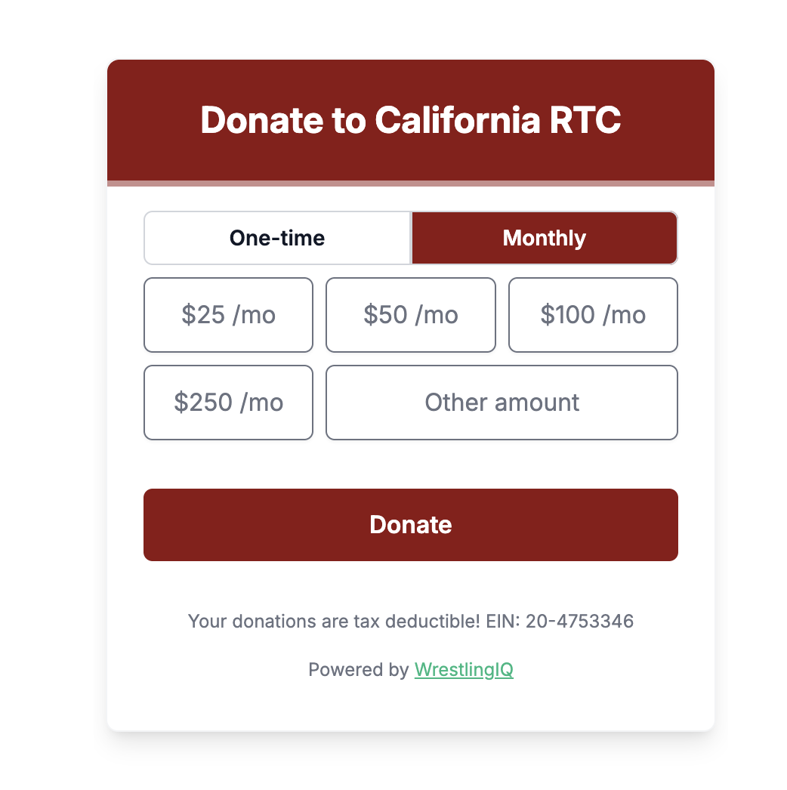
PAYMENTS
What you can run through one system
GIVING
Donation pages
RECURRING
EVENTS
MERCH
Fundraisers
Ticketed events
Spirit stores
A standing link for alumni and local businesses, live year-round.
Team-wide campaigns with a page you can send anywhere.
Team BBQ, banquet, alumni duals — collect before, not at the door.
Shirts and gear without a parent fronting the money.
Booster accounts give you a source of funds you have more control over. Work with your AD to ensure this process is running smoothly and you can collect funds online.
WrestlingIQ
3rd Annual Coaches & Leaders Clinic · Stanford · Sept 12, 2026
Notes:
Original notes:
- Fundraiser screenshots
- Ticketed events like BBQs etc
- Spirit stores
- Donation assistant and donation page
- How to decide on booster payments
The red-tape point came from Ray Blake in Oklahoma: "there's an excessive amount of red tape involved in collecting and depositing payments through the school. Ability to bypass with a direct link to the booster account helps tremendously." It's on the slide unattributed, since Ray isn't presenting.
OPEN: ask Dan what this looks like in a California district before the clinic — he can give the room the local version instead of a second-hand one.
OPEN: add fundraiser / spirit store screenshots.
For dan, how do AD’s feel about this?

Slide 24
04
AI — is the future now?
How to think about it, and how not to.
WrestlingIQ
3rd Annual Coaches & Leaders Clinic · Stanford · Sept 12, 2026

Slide 25
AI
How to think about AI
A thinking partner where you already have expertise
It's useful when you can tell whether the answer is any good. That's the whole test.
It's software you use as leverage — not a genie
Even when it feels like one. Leverage multiplies your judgment; it doesn't supply it.
Wrestling is a human thing
Remove the unnecessary drudge work of running a team. Do not remove the parts that make it worth doing.
Read the room in your community
Some parents and ADs have strong feelings. Know where yours sit before you lean in.
Role model the effort
If you can't be bothered to put the work in, your wrestlers won't either.
WrestlingIQ
3rd Annual Coaches & Leaders Clinic · Stanford · Sept 12, 2026
Notes:
Original notes:
- AI as a thinking partner when you have deep expertise, not as a replacement for critical thinking
- AI is fundamentally software that you use as leverage. It is not a genie, even if it feels like it
- Remember, wrestling and youth sports in general is fundamentally a human thing
- This is literally why WIQ exists: software to save time. We want to remove the unnecessary drudge work of running a team, not the unique parts that make it worthwhile. This is the true lens of "should AI do this for me"
- Read the room in your community
- Role model to your team how to use it

Slide 26
AI
Common mistakes
MISTAKE
MISTAKE
MISTAKE
No context
No source material
No verification
You know your program, your district and your kids. The model knows none of it until you tell it.
Ask it to work from your documents and cite them, rather than from whatever it half-remembers.
If you can't check the output, you shouldn't be using it for that job yet.
What does AI and tattoos have in common?
WrestlingIQ
3rd Annual Coaches & Leaders Clinic · Stanford · Sept 12, 2026
Notes:
Original notes:
- Have Dan riff on AI on common mistakes he sees people make
- Maybe even have Dan give an example of 'context' he shares with AI, his design system, how he prompts to always reference source materials etc.
Original title was "Tattoos and AI, common problems."
OPEN: confirm with Dan what he wants on screen while he riffs.

Slide 27
AI
Where it earns its keep — and where it doesn't
GOOD USE CASES
BE CAREFUL
Anything with a defined output the AI can check itself against, or that is very well known.
Anywhere the output is your voice, or nobody can verify it before it ships.
Analyzing a data set
Written messages to your team
"Find every online tournament near us"
Anything a parent will read as you
Formatting documents and video
Yet another graphic everyone knows is slop
WrestlingIQ
3rd Annual Coaches & Leaders Clinic · Stanford · Sept 12, 2026
Notes:
Original notes:
Good: anything with a defined output that the AI can verify against or is very well known. Examples: analyze data sets; go find all tournaments on USA bracketing that are online near us and give me a succinct list; reformatting documents / videos.
Bad: careful with written words. Highlight video generation can be really helpful (stitch x clips together, etc).

Slide 28
YOUR TURN
Talk it through
Find two or three people near you. Ten minutes.
QUESTION 1
QUESTION 2
QUESTION 3
What are you using today?
What could you delete?
What's your one script?
List every system your program touches. Where does the same information live in two places?
Which tool would nobody miss, and what would it take to consolidate it this season?
Write the sentence you'll use all season to redirect people back to the calendar.
Come back with one thing you'll change before your first practice.
WrestlingIQ
3rd Annual Coaches & Leaders Clinic · Stanford · Sept 12, 2026
Notes:
Original note (slide 29, peer review): "Have breakout groups or time for them to jot notes? Other thoughts? This is a 90 minute session, do we have enough stuff in here?"
Also from slide 2: "What are you using for all these things? Condense as possible." — that's question 1 here.
OPEN: decide timing. Ten minutes here plus the demo gets a 90-minute session comfortably full. Bring paper and pens if you want them jotting notes.

Slide 29
05
Q&A - Thank you!
WrestlingIQ
3rd Annual Coaches & Leaders Clinic · Stanford · Sept 12, 2026

