Slide 1


Performance Character
09/2026

Slide 2
40 Second Self-Description
Each person at the table will get 40 seconds to describe themselves with ”I” statements.
  I am…
  I love…
  I dislike…
  I have…

Slide 3
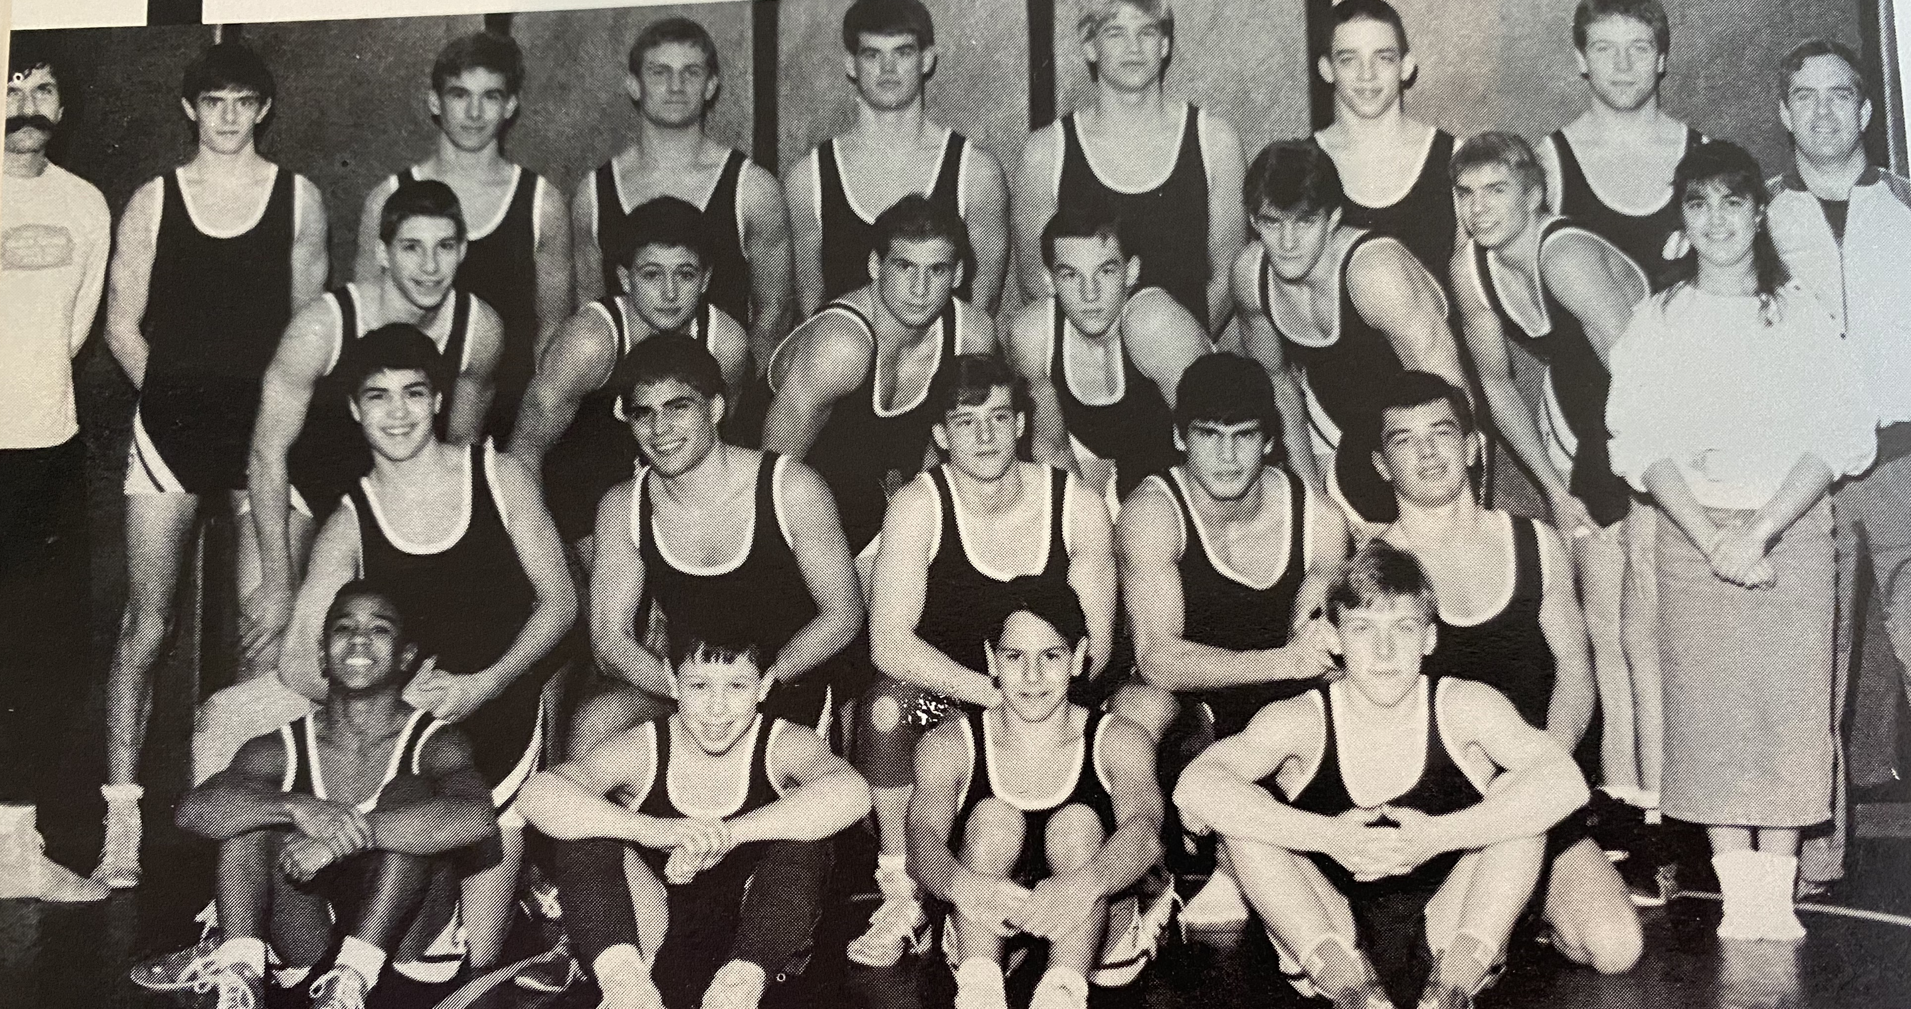

Background

Slide 4
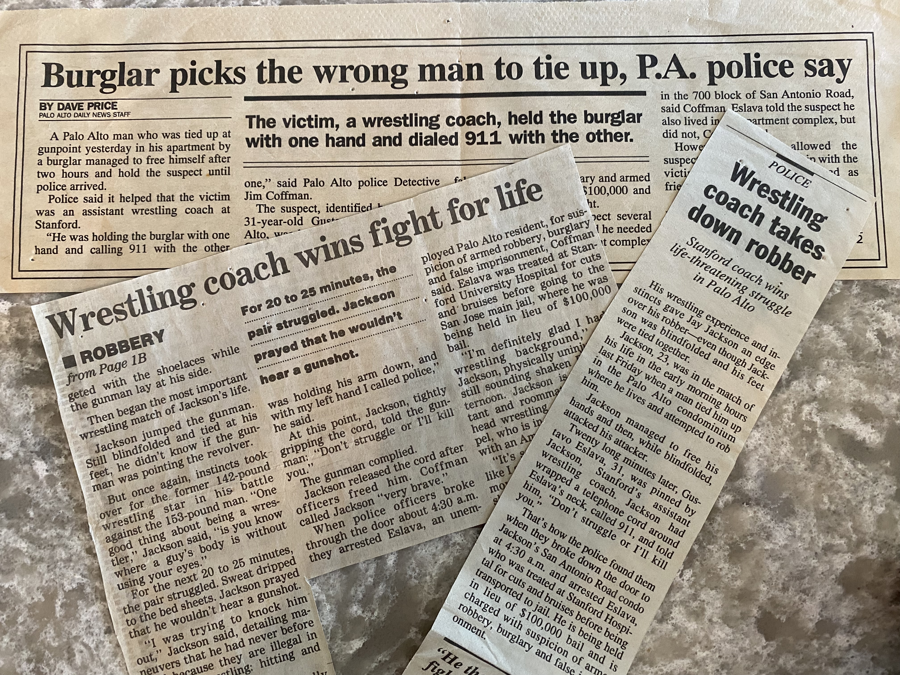

Slide 5
Performance Character
The mindset and behaviors necessary to best take on a challenge successfully and joyfully.

Slide 6
Why is Performance Character Important?
Wrestlers encounter challenges every day in practice and competition. How much time do we spend on why they’re taking on those challenges and how to get through them when the challenge is difficult?
Athletes need to know that they can be in control of challenges rather than victims.

Slide 7




Slide 8

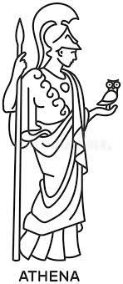
Parthenon of Performance Character
Which do you think is the most important component of Performance Character?
Flow
GRIT
P a s s i o n
P e r s e v e r a n c e
Ego starts to vanish while joy and success is the result.
Emotion
Purpose
Positive Thought
Courage
Commitment
I n t e g r i t y
S e l f - A w a r e n e s s
Ego lives down here

Slide 9
Performance Character Tools
Concepts are ambiguous – visuals make them more concrete.
Visuals engage both sides of the brain.
Concepts are personal to the individual – not a one-size-fits-all situation.
Coupling a diagram with questions allows a person to determine their personal ideas/thoughts about performance character concepts.
Discussion allows people access to different opinions.

Slide 10
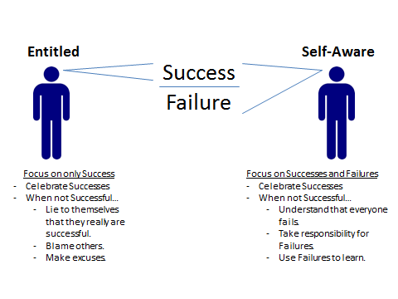

Slide 11
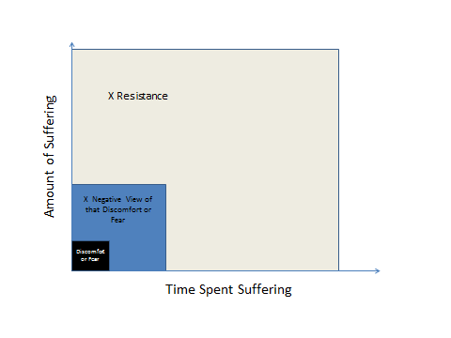
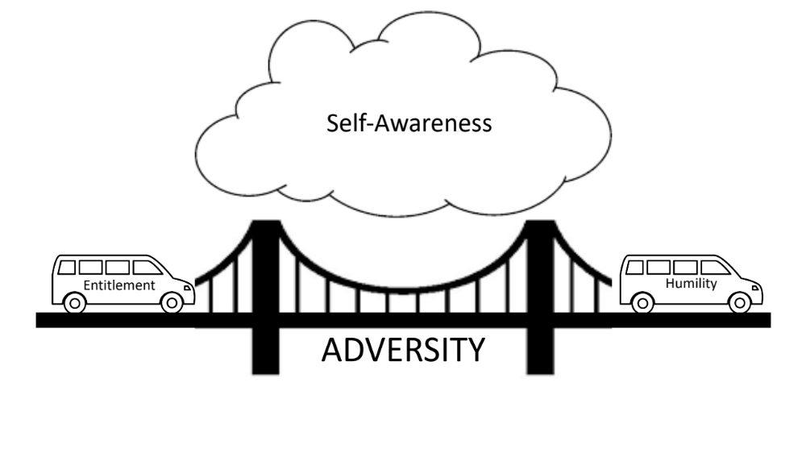

Slide 12
Success
II
I
Dishonorable
Honorable
III
IV
Failure

Slide 13
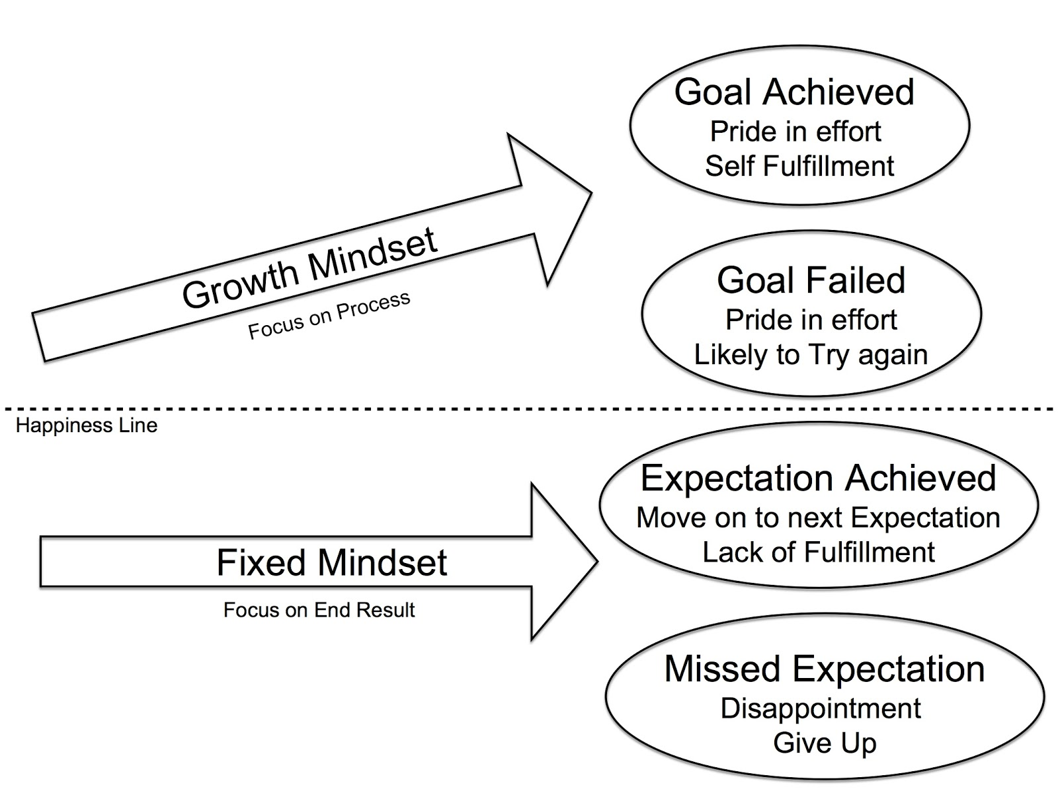

Slide 14
Event + Response = Outcome

Slide 15
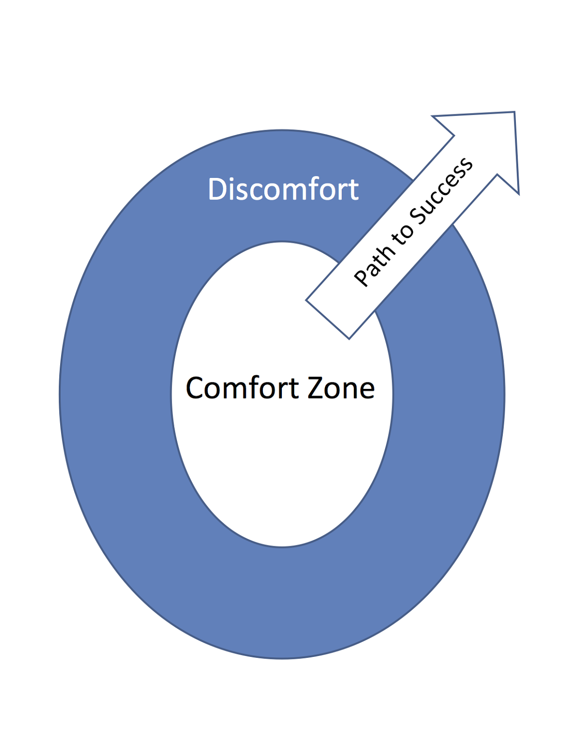

Slide 16
Questions
What is fear?
How do you know when you’re experiencing fear?
Is anything at work fear-inducing for you?
Is fear a good thing or a bad thing?
What is courage?

Slide 17
Fear
Resistance
Acceptance

Slide 18
Fear
Anxiety
Resistance
Acceptance

Slide 19
Fear
Excitement
Resistance
Acceptance

Slide 20

Perceived
Negative
Outcomes
Perceived
Positive
Outcomes

Slide 21
Perceived
Negative
Outcomes
Irrational Fear
Perceived
Positive
Outcomes

Slide 22
Perceived
Negative
Outcomes
Overconfident
Perceived
Positive
Outcomes

Slide 23
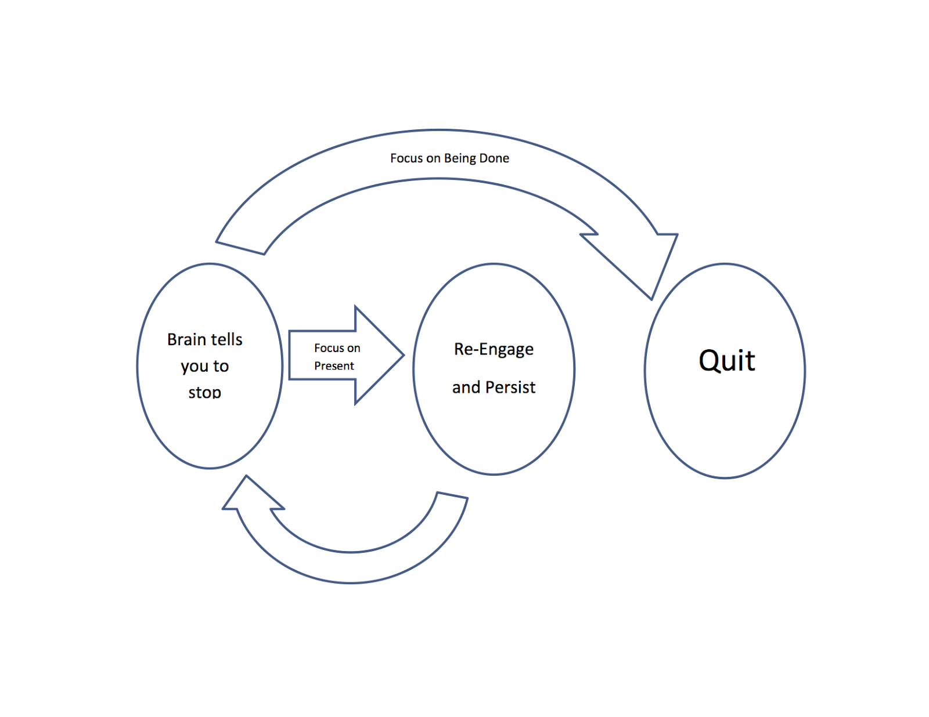

Slide 24
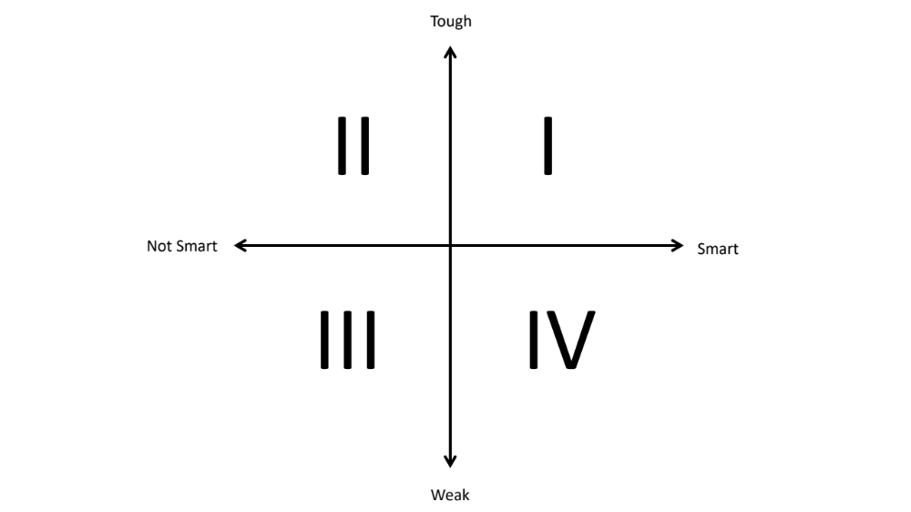

Slide 25
World Class
With Deliberate Practice
Sweet Spot
Expertise
Without Deliberate Practice
Hours of Practice
10,000 Hours

Slide 26
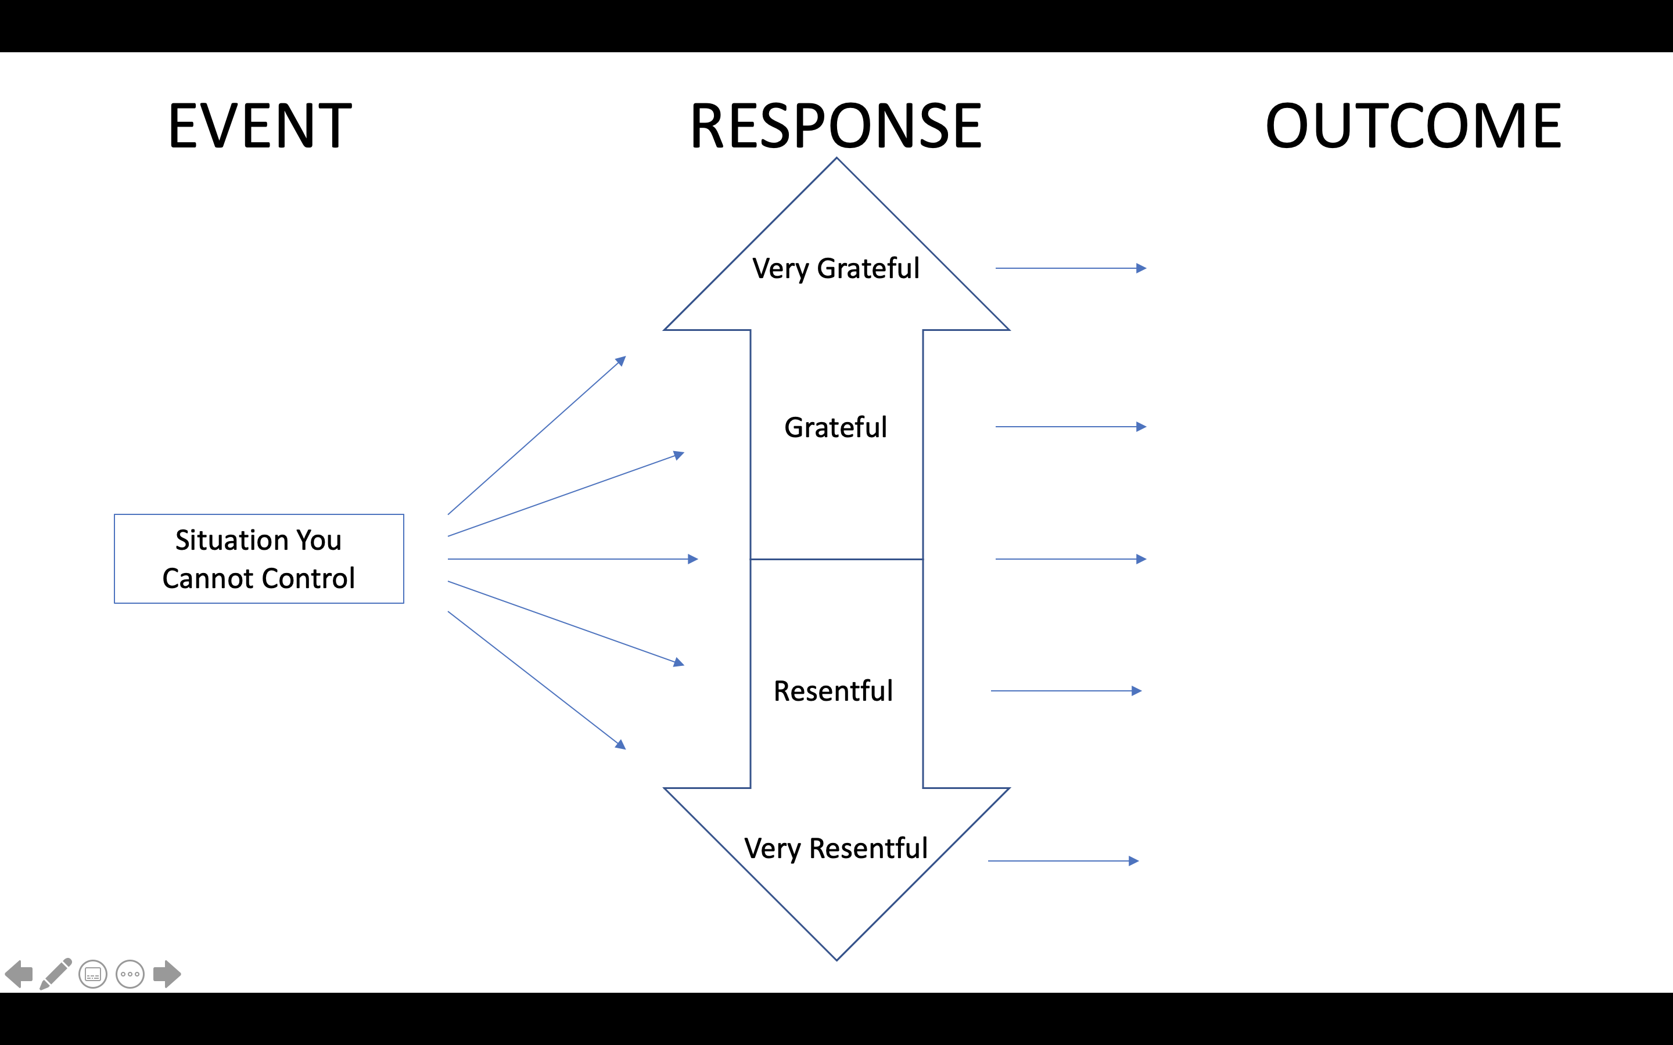

Slide 27
Flow State Questions
Flow state is when you are completely focused on the moment. In flow state, the person feels selfless, the experience is rich, the event is timeless, and the action feels effortless.
Have you ever been in flow state?
Can you provide an example?
What did it feel like?
If you wanted to get into flow state, how would you do it?

Slide 28
Pleasure vs. Joy questions
Pleasure is flow state that you don’t have to work for.
Joy is flow state that takes effort.
Provide some examples of pleasure and some examples of joy.
Are video games an example of pleasure or joy?
Are students more likely to be attracted to pleasure or joy?
What are side effects of pleasure? What are side effects of joy?

Slide 29
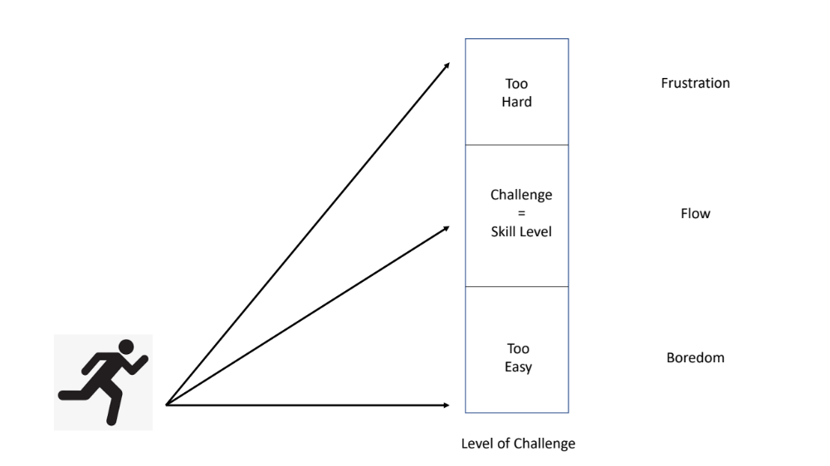
Which level do athletes find themselves in practice/competition most often, Frustration, Flow, or Boredom?
Whose responsibility is it to match challenge with skill level in a class, the coach or the athlete?
How can you help your athletes find Flow State in your practice?

Slide 30
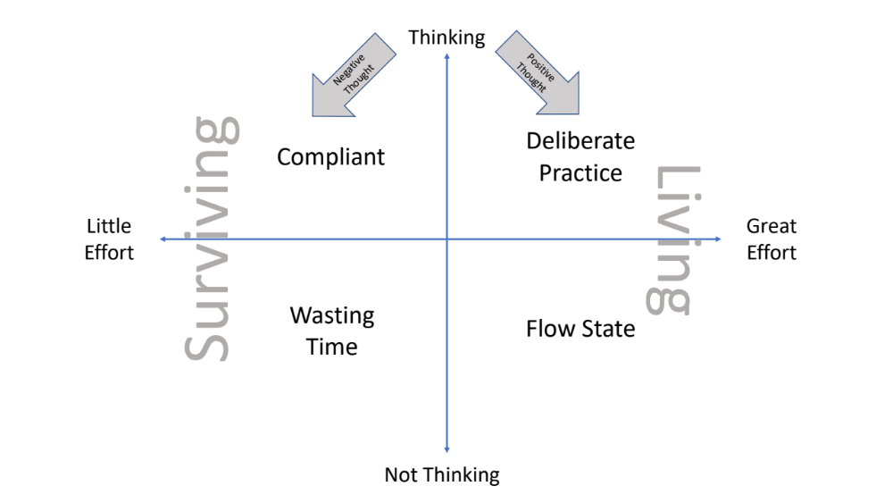

Slide 31
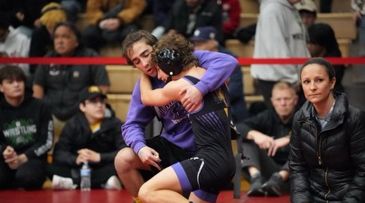
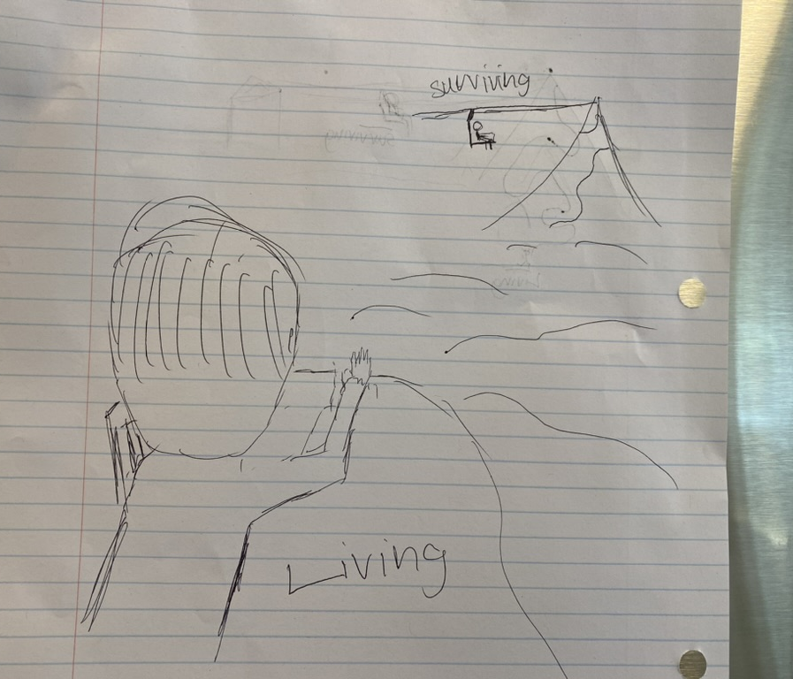
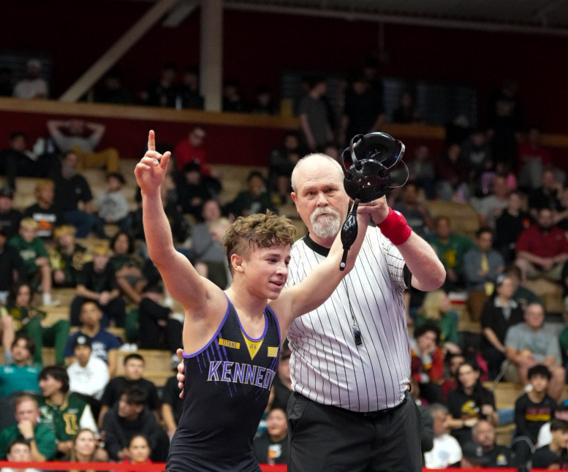

Slide 32
Parthenon of Performance Character
How can you better support your students?
Flow
GRIT
P a s s I o n
P e r s e v e r a n c e
Ego starts to vanish while joy and success is the result.
Emotion
Purpose
Positive Thought
Courage
Commitment
Support
I n t e g r i t y
Support
S e l f - A w a r e n e s s
Ego lives down here

Slide 33
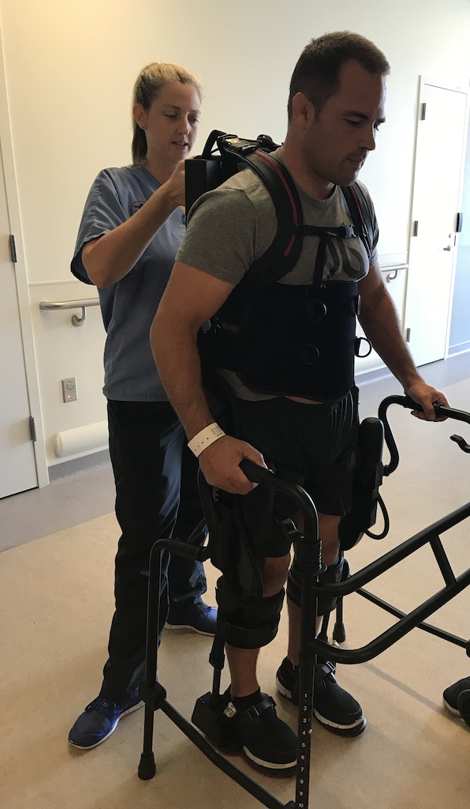
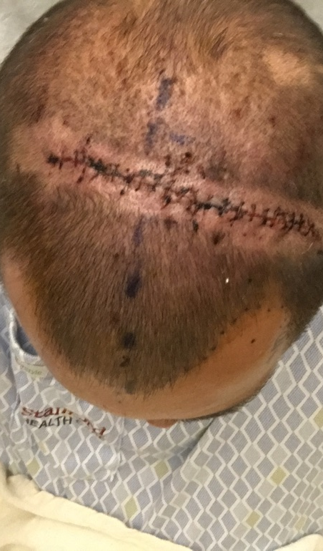
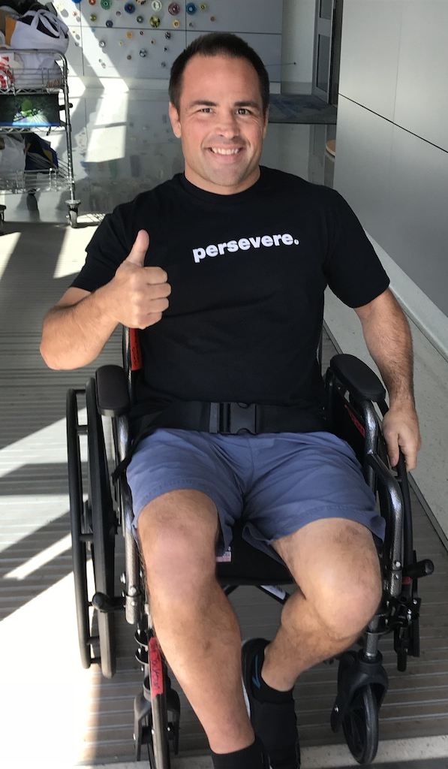

Slide 34


Jay Jackson
Books:
amazon.com
Email:
foghorn@stanfordalumni.org
Website: uptothechallengejayjackson.com

